Slide 1
Sinhgad College of Engineering Department of Information Technology
Project Review
On
“Prediction of Heart Disease Using Machine Learning algorithm ”
by
Roll No | Name
407182 | Viraj Satish Varale
407160 | Sunil Gurjar
407109 | Komal More
407159 | Apurva Bhusari
Guide
“Dr. Mrs. Kalpana S. Thakare”

Slide 2
Project Title
“Prediction Of Heart Disease Using Machine Learning”

Slide 3
Contents
Introduction
Aim & Objective
Problem statement
Literature Survey
Scope
Architecture
Implementation of Proposed system
System Design
Results
Other specification
Conclusion
References

Slide 4
1. Introduction
Heart disease is responsible for a third of all global deaths.
Most of them are in the developing world.
Nearly 18 million died of heart disease.
More than three-quarters of those deaths occurred in the developing world.
15% of deaths in India were due to heart diseases in 1990;
now up to 28%.
Diagnosis of heart disease has become a difficult task in the
field of medicine .

Slide 5
2. Aim
To determine prediction of heart disease using 4 different machine learning algorithms Random Forest, Naïve Bayes, Logistic Regression and Voting Classifier.
Objective
To preprocessing of Cleveland dataset to able to use for training and testing of machine learning algorithms.
To learn algorithm such as Random Forest, Naïve Bayes, Logistic Regression and Voting Classifier.
To predict probability of heart disease in percentage.
To provide real time heart rate as input for trained machine learning model.

Slide 6
3. Problem Statement
To design and implement a prediction system, that predict and analysis of the heart disease using machine learning algorithm like random forest, Naive Bayes and logistic regression.

Slide 7
4. Literature Survey
1.“Effective Heart Disease Prediction Using Hybrid Machine Learning Techniques, 2019”
Author proposes HRFLM (Hybrid random forest and linear model)Technique to predict heart disease.
HRFLM system used random forest and linear model algorithm for prediction of heart disease.
HRFLM model achieved 88.7 % accuracy
Compare results of different algorithms with HRFLM model
Performance of HRFLM system is calculated using Rstudio rattle software.

Slide 8
2. ” A Real Time Patient Monitoring System for Heart Disease Prediction Using Random Forest Algorithm”
The proposed work suggests portable Patient monitoring system with various sensitive parameters, wireless devices and smart phones.
System uses random forest algorithm to predict heart disease.
System achieved 84.48 % accuracy
System provides patient and doctor messaging facility, generate and forwards alarm messages to the related doctor and relatives of patient
System uses Cleveland dataset from uci repository for training and testing model
.

Slide 9
3.” Heart Disease Prediction System using Naive Bayes ”
Author proposes a prediction system using Naïve Bayes algorithm.
System categories output result into five categories namely no, low, average, high and very high.
System used python sklearn libraries to implement Naïve Bayes algorithm.
System used confusion matrix for performance analysis
System achieved 88.76 % accuracy
System uses 10 fold cross validation technique to train and test Naïve Bayes algorithm.

Slide 10
4.Heart Disease Prediction using Logistic Regression Algorithm using Machine Learning
Author proposed prediction of heart disease using Logistic regression algorithm
Author compares Different algorithms KNN, SVM, NB, Decision Tree with Logistic regression.
System achieved 86.89% accuracy with logistic regression.
System uses Sklearn libraries to import KNN , Logistic regression , Naïve Bayes, decision tree algorithm.
Performance of system is calculated using confusion matrix.
System uses sigmoid activation function to map predicted values to probabilities.

Slide 11
5. Scope
Beginning with collecting important clinical information from wearable gadget using heart rate sensor and from patient clinical dataset.
Developing codes for classifiers for first training over sample data and after that testing data to improve accuracy of prediction.
Developing codes for android apps for transferring gathered data to server in which heart disease prediction system is implemented.
Results will be then shown to the patient using android platform.

Slide 12
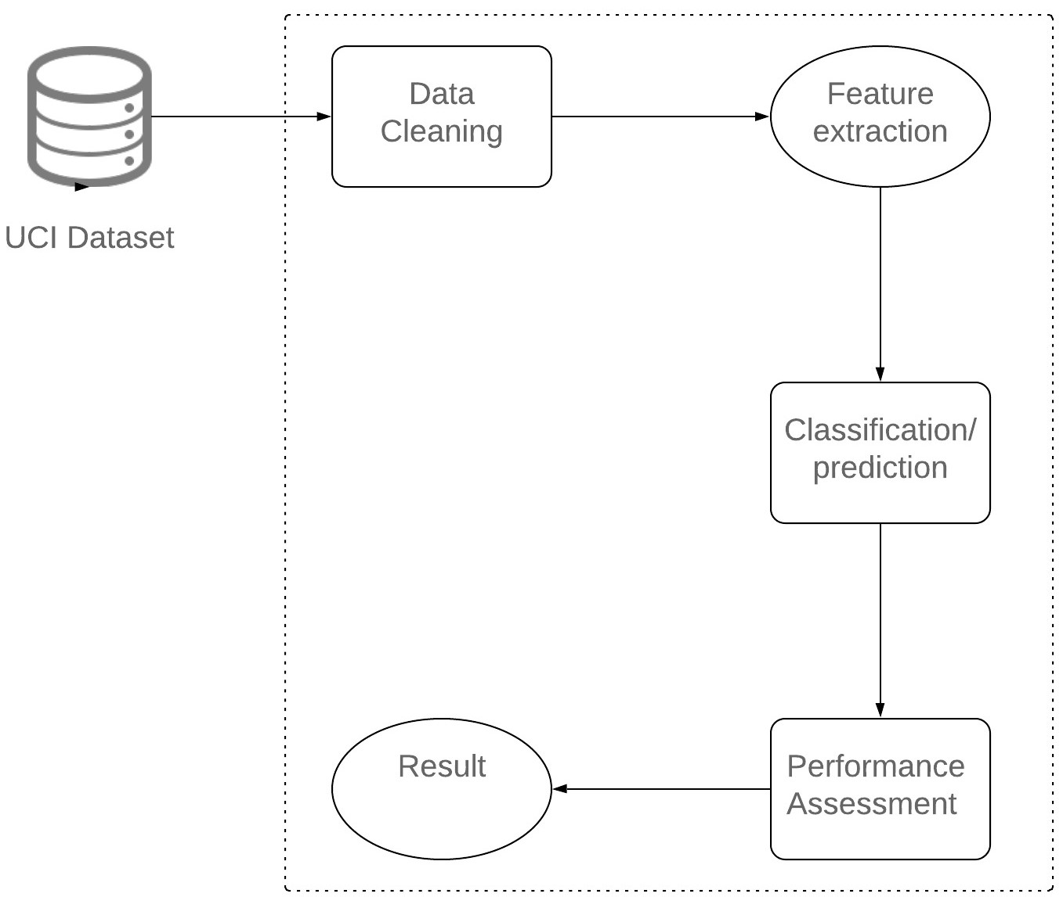
6. Proposed system architecture

Slide 13

6.1 Dataset
Dataset -
Using Cleveland dataset from uci repository
13 attributes with label
11 attributes contains clinical medical records
Cleveland dataset used to train and test proposed system model

Slide 14
UCI Dataset
We are using Cleveland dataset from UCI repository of machine learning for training and testing phase.
Total 13 features are given in Cleveland dataset:-
Age.
Chest pain represented in 4 values.
Cholesterol level.
Blood sugar level.
ECG result.
Max rate of heart.
Angina induced by exercise.
Exercised induced ST depression in comparison with state of heart.
Fluoroscopy color vessel numbered from 0 to 3.
Status of heart normal-3 defect-6 reversible defect -7.
Fluoroscopy colored major vessel number from 0 – 3.
Heart disease diagnosis represented in 5 values.
Sex -0 for male and 1 for female.

Slide 15
6.2 Data cleaning/pre processing :
Importing libraries
Import dataset
Data cleaning
Scaling
Splitting the dataset into training and testing
6.3 Feature selection
Chi Square method
Selectkbest

Slide 16
Chi square method
A chi-square (χ²) statistic is a test that measures how expectations compare to actual observed data
For each observed number in the table subtract the corresponding expected number (O — E).
Square the difference [ (O —E)² ].
Divide the squares obtained for each cell in the table by the expected number for that cell [ (O - E)² / E ].
χ2 =X i (Oi −Ei)2 /Ei

Slide 17
6.4 Classification/prediction
Proposed system uses different machine learninig algorithms
Random forest
Naïve Bayes
Logistic regression
Voting classifier
Voting classifier is ensemble algorithm which used different classifier to get one result

Slide 18
6.4.1 Random Forest Algorithm
Precondition: A training set S := (x1, y1), . . . ,(xn, yn), features F, and number of trees in forest B.
1 function RandomForest(S , F)
2 H ← ∅
3 for i ∈ 1, . . . , B do
4 S (i) ← A bootstrap sample from S
5 hi ← Randomized TreeLearn(S (i) , F)
6 H ← H ∪ {hi}
7 end for
8 return H
9 end function
10 function Randomized Tree Learn(S , F)
11 At each node:
12 f ← very small subset of F
13 Split on best feature in f
14 return The learned tree
15 end function

Slide 19
6.4.2 Naïve Bayes algorithm
The Naive Bayes algorithm is based on Bayesian theorem as given by equation (1.1) Steps in algorithm are as follows:
1. Each data sample is represented by an n dimensional feature vector, X = (x1, x2….. xn), depicting n measurements made on the sample from n attributes, respectively A1, A2, An.
2. Suppose that there are m classes, C1, C2……Cm. Given an unknown data sample, X (i.e., having no class label), the classifier will predict that X belongs to the class having the highest posterior probability, conditioned if and only if: P(Ci/X)>P(Cj/X) for all 1< = j< = m and j!= i Thus we maximize P(Ci|X). The class Ci for which P(Ci|X) is maximized is called the maximum posteriori hypothesis. By Bayes theorem,
3. As P(X) is constant for all classes, only P(X|Ci)P(Ci) need be maximized. If the class prior probabilities are not known, then it is commonly assumed that the classes are equally likely, i.e. P(C1) = P(C2) = …..= P(Cm), and we would therefore maximize P(X|Ci). Otherwise, we maximize P(X|Ci)P(Ci). Note that the class prior probabilities may be estimated by P(Ci) = si/s , where Si is the number of training samples of class Ci, and s is the total number of training samples. on X. That is, the naive probability assigns an unknown sample X to the class Ci

Slide 20
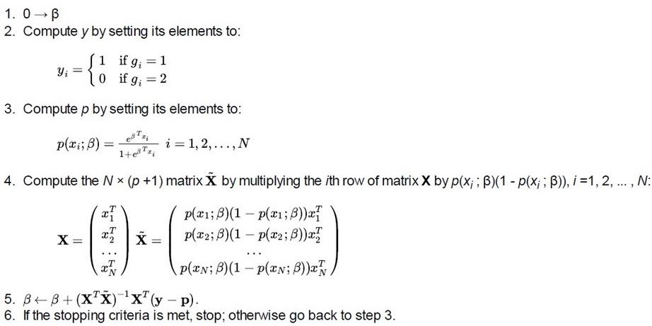
6.4.3 Logistic regression

Slide 21
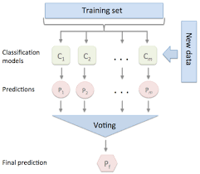
6.4.4 Voting classifier
Algorithm used in voting classifier
C1- Random forest
C2- Naïve Bayes
C3- Logistic regression
Voting
Hard voting
Soft voting

Slide 22
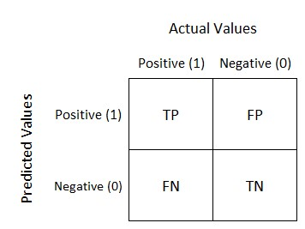
6.5 Performance analysis
Confusion matrix
Accuracy
Accuracy = (TP+TN)/N, where N =TP+TN+FP+FN .
Recall
Precision = TP/ (TP+FP)
Precision
Recall = TP/ (TP+FN)

Slide 23
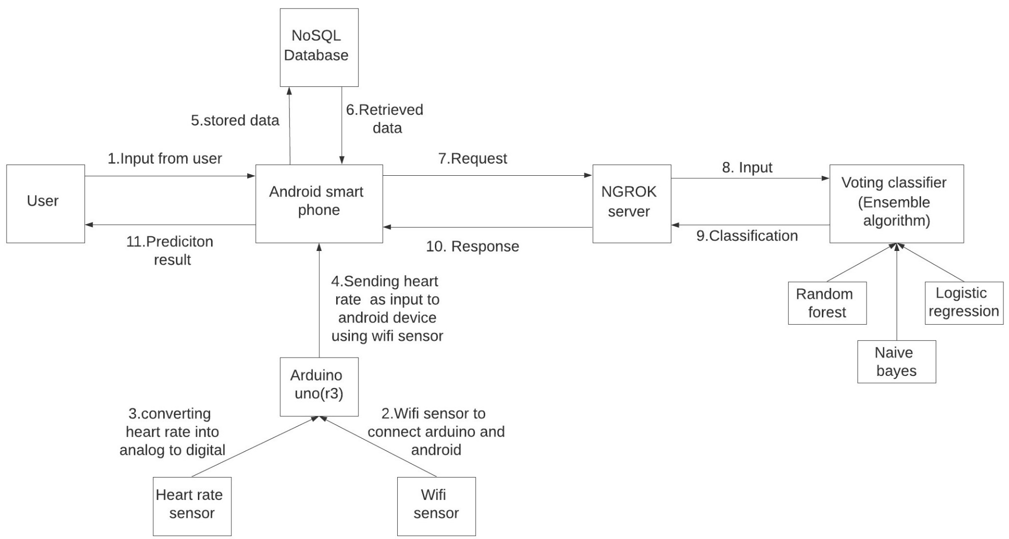
7.Implementation Proposed system

Slide 24
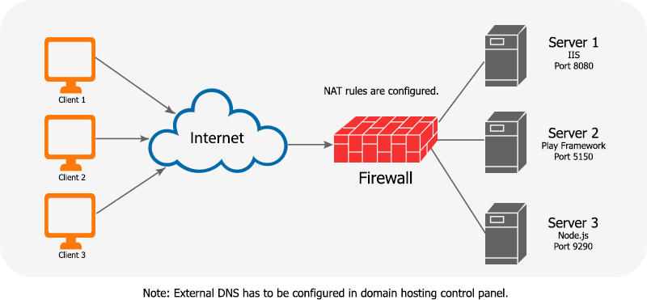
Proposed system is divided into 3 main parts:
Server
Android(client)
Sensors
NGROK server
Server includes
Flask
Micro web framework
JSON
Machine learning algorithms

Slide 25
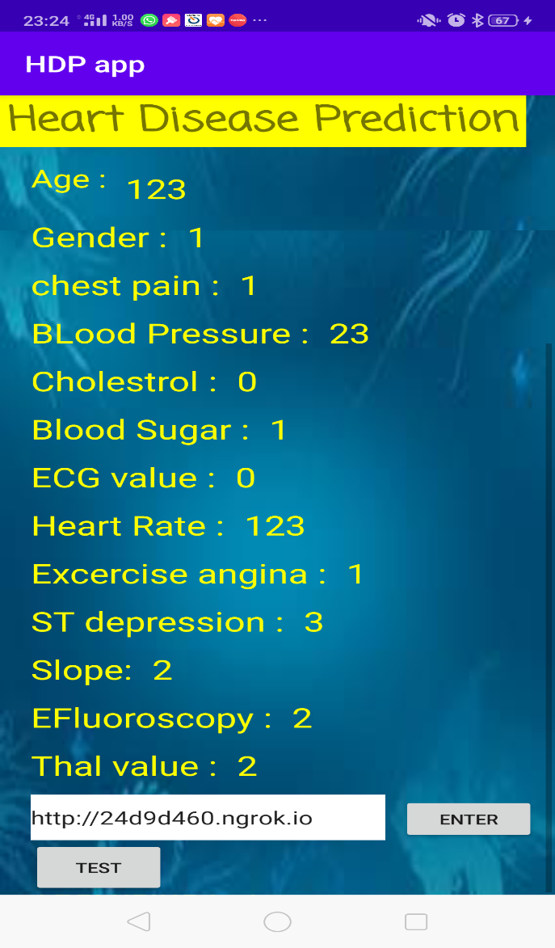
Android:
Client side
Language used java
Register activity
Login activity
Input activity
Final activity
Result activity
Result show in two types
0 and 1
0 indicates patient does not have
heart disease
1 indicates patient have heart disease
2. Probability in percentage

Slide 26
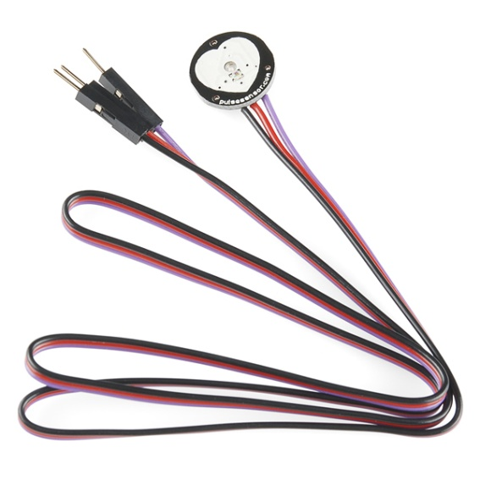
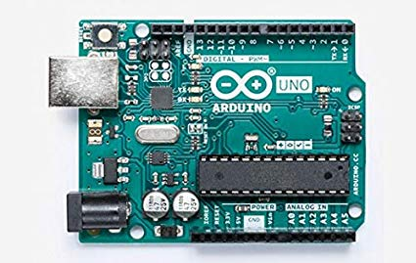
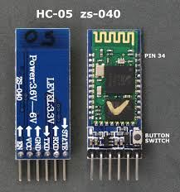
Real time heart rate system for
prediction
Arduino(UNO)
Heart rate sensor
Wi-Fi esp8266 module
ThinkSpeak Server

Slide 27
8. System design

Slide 28
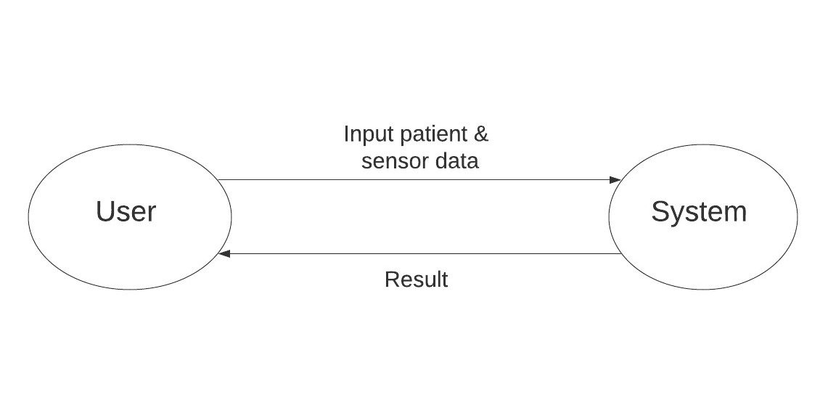
8.1 Data flow diagram level 0
DFD LEVEL 0

Slide 29
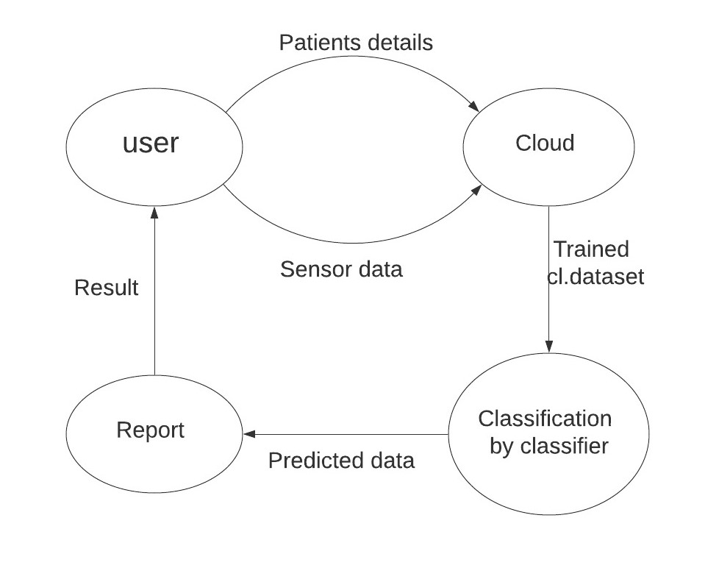
8.2 Data flow diagram level 1
DFD LEVEL 1

Slide 30
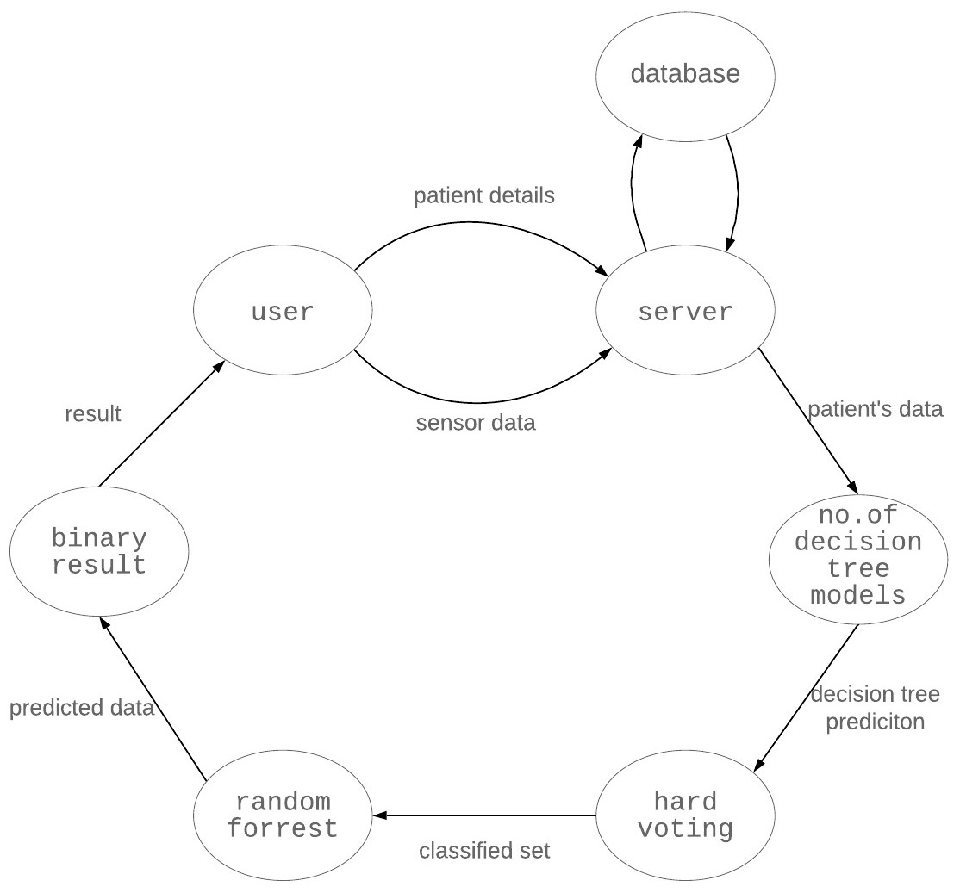
8.3 Data flow diagram level 2
DFD LEVEL 2

Slide 31
8.4 Use case diagram

Slide 32
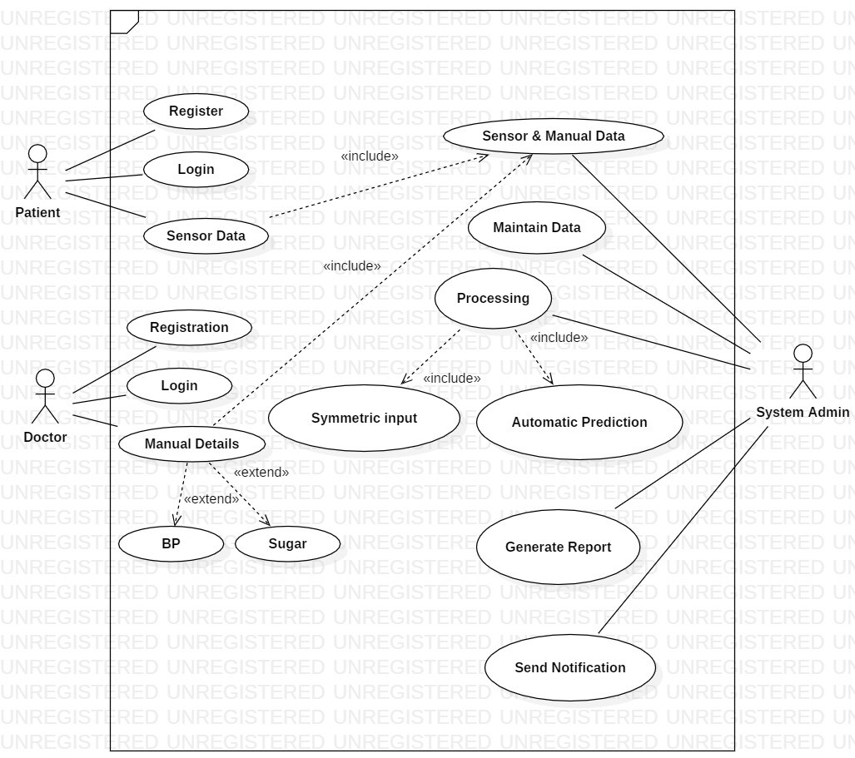

Slide 33
8.5 Sequence Diagram

Slide 34
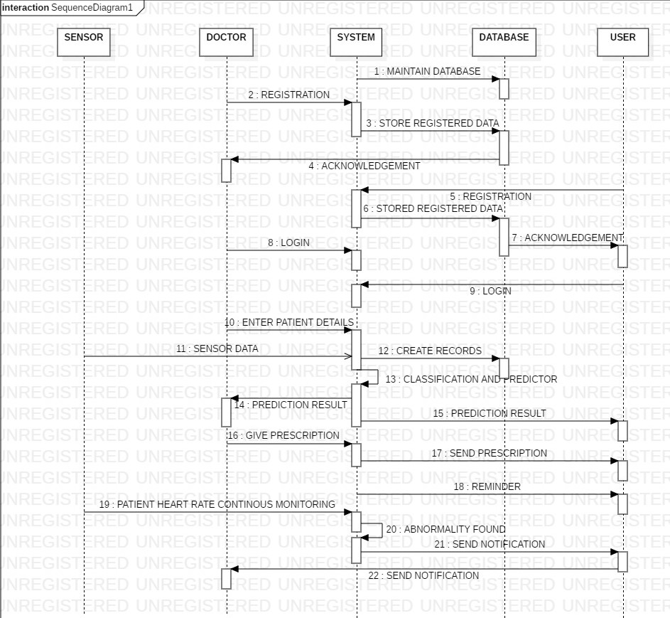

Slide 35
8.6 Activity Diagram

Slide 36
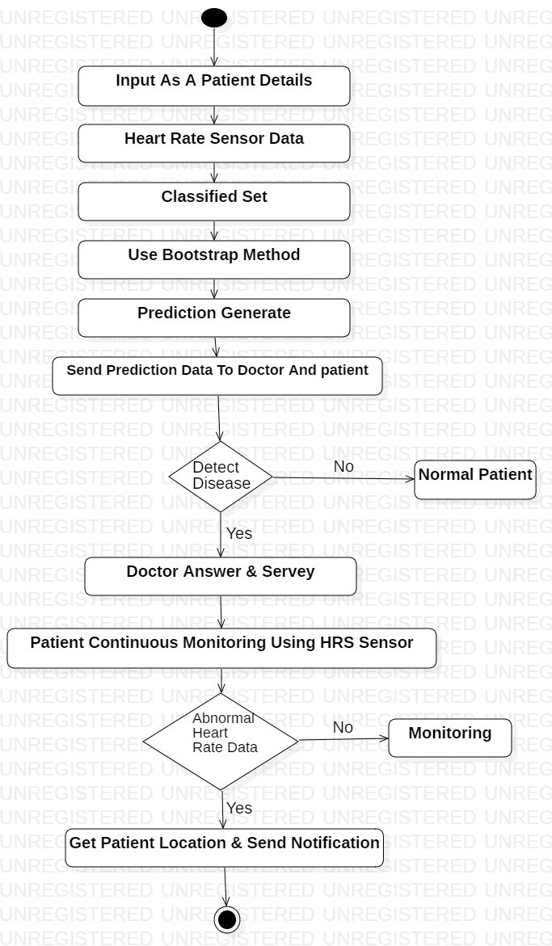
ACTIVITY
DIAGRAM

Slide 37
8.7 Class Diagram

Slide 38
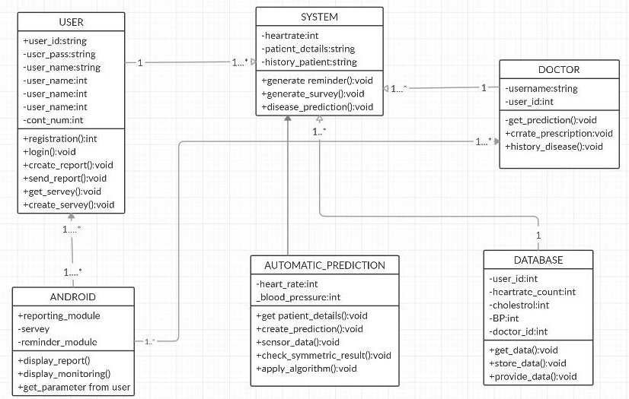
CLASS DIAGRAM

Slide 39
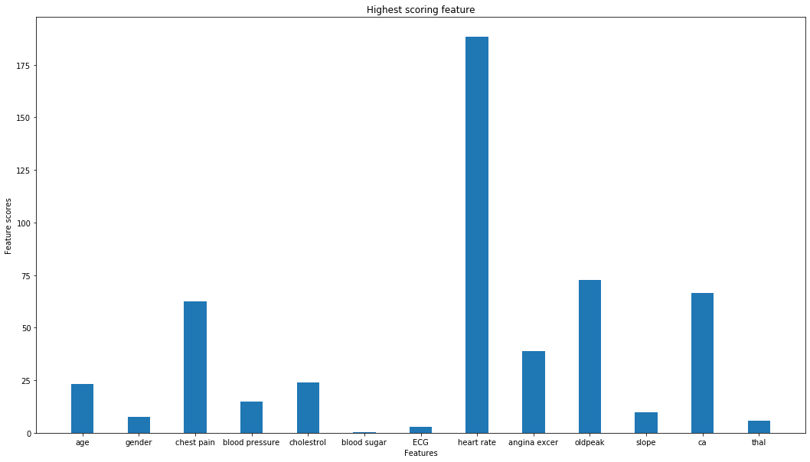
9. Results
Chi square method
Features | Chi square test score
Age | 23.29
Gender | 7.58
Chest pain | 62.60
Blood pressure | 14.82
Cholesterol | 23.94
Blood sugar | 0.20
ECG | 2.98
Heart rate | 188.32
Angina excel | 38.91
Old peak | 72.64
Slope | 9.80
Fluoroscopy | 66.44
Thal | 5.79

Slide 40
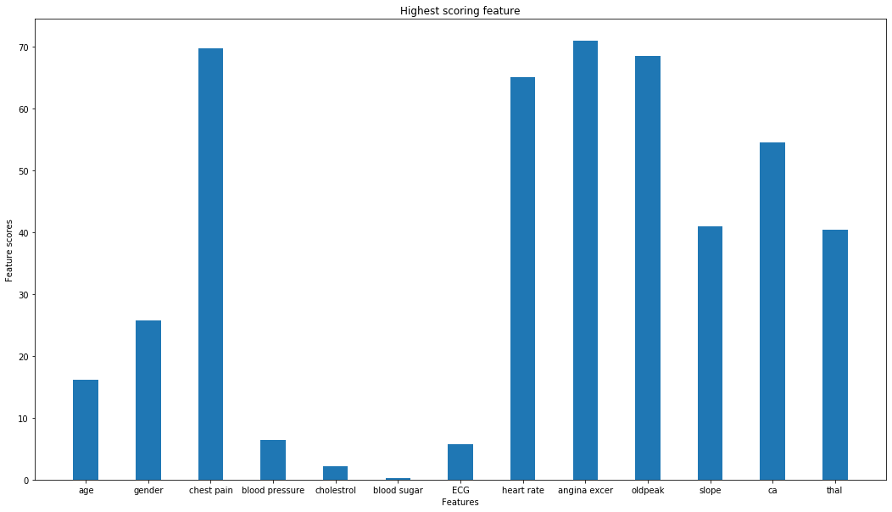
Results
F-measure score
Features | F-measure test score
Age | 16.12
Gender | 25.79
Chest pain | 69.77
Blood pressure | 6.46
Cholesterol | 2.20
Blood sugar | 0.24
ECG | 5.78
Heart rate | 65.12
Angina excer | 70.95
Oldpeak | 68.55
Slope | 40.90
Fluoroscopy | 54.56
Thal | 40.41

Slide 41
Results
Confusion matrix table
Algorithm | TP | FP | FN | TN | Total sample
Random forest | 32 | 6 | 2 | 36 | 76
Naïve Bayes | 34 | 4 | 4 | 34 | 76
Logistic regression | 33 | 5 | 2 | 36 | 76
Voting classifier | 36 | 2 | 2 | 36 | 76
Accuracy ,precision and recall table
Algorithm | Accuracy | Precision | Recall | Error rate
Random Forest | 90.78 | 88.39 | 88.39 | 10.52
Naïve Bayes | 89.47 | 89.47 | 89.47 | 10.52
Logistic Regression | 90.78 | 87.80 | 94.73 | 9.21
Voting Classifier | 94.73 | 94.73 | 94.73 | 5.26

Slide 42
10. Other specification
Advantage
Proposed system maintain its accuracy in case of missing input values.
Proposed system accuracy is 94.4%
Easy user interface
Portable
Limitations
System accuracy is depend on patient’s clinical report.
Patient have to rely on doctor for diagnosis of heart disease as it required necessary medical report like fluoroscopy , ECG, blood pressure.
Proposed system does not detect type of heart disease. It predicts patient have heart disease or not.

Slide 43
11. Conclusion
Finding the processing of raw healthcare data of heart information will help in the long term saving of human lives and early detection of abnormalities in heart conditions.
Proposed system used machine learning techniques to process raw data and provide a new health care system to predict heart disease.
Diagnosis of heart disease is challenging and very important in the medical ﬁeld. The premature deaths can be reduced if the heart disease is detected at the early stages and preventative measures are taken.
This proposed system used Cleveland dataset to predict heart disease. The proposed system approach is used combining the characteristics of Random Forest (RF), Naïve Bayes (NB) and Logistic Regression (LG) with the help of Voting Classifier (VC).
Proposed system proved to be quite accurate in the prediction of heart disease.
The future course of this research can be performed with diverse mixtures of machine learning techniques to better prediction techniques. Furthermore, new feature selection methods can be developed to get a broader perception of the signiﬁcant features to increase the performance of heart disease prediction

Slide 44
12. References
[1] “EFFECTIVE HEART DISEASE PREDICTION USING HYBRID MACHINE LEARNING TECHNIQUES SENTHILKUMAR MOHAN 1, CHANDRASEGAR THIRUMALAI1 AND GAUTAM SRIVASTAVA 2,3, (Member, IEEE)”
[2] A REAL TIME PATIENT MONITORING SYSTEM FOR HEART DISEASE PREDICTION SYSTEM USING RANDOM FOREST S. SREEJITH, S. RAHUL AND R.C. JISHA
[3] “INTELLIGENT HEART DISEASE PREDICTION DISEASE PREDICTION SYSTEM USING RANDOM FOREST AND EVOLUTIONARY APPROACH M. A. JABBAR1, B. L. DEEK- SHATULU2 AND PRITI CHANDRA3”
[4] HEART DISEASE PREDICTION SYSTEM USING NAÏVE BAYES DHANASHREE S. MEDHEKARL, MAYUR P. BOTE AND SHRUTI D. DESHMUKH
[5] HEART DISEASE PREDICTION USING LOGISTIC REGRESSION ALGORITHM USING MACHINE LEARNING REDDY PRASAD, PIDAPARTHI ANJALI, S.ADIL AND N.DEEPA

Slide 45
THANK YOU

